Slide 1
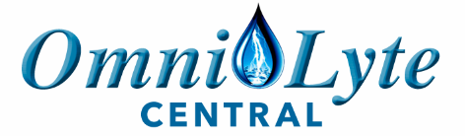
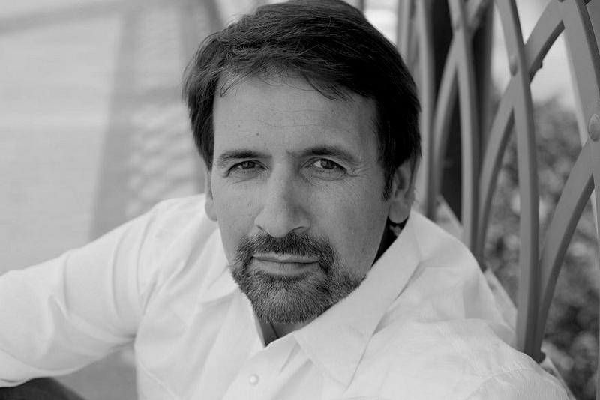
Sam Hofer: Sales & Marketing
Phone: 270-318-0677
Email: sam@OmniLyteUSA.com
Website: omnilytecentral.com

Slide 2
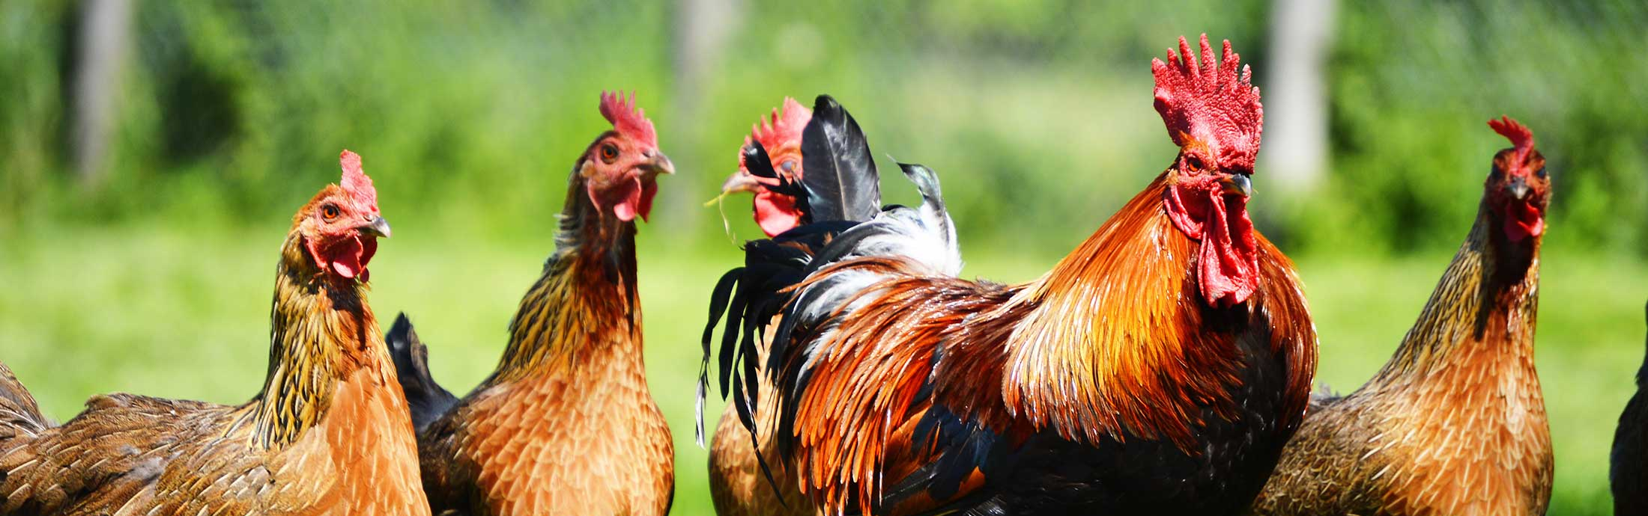
WATER PURFICIATION: CHICKENS
Control & Reduction of Disease
Better Digestion & Feed Conversion Ratios
Increasing Live Stock yields

Slide 3

INCREASED PROFITIBILITY
INCREASED SAFETY
ELIMINATE ANTIBIOTIC USE
ELIMINATE TOXIC CHEMICAL USE

Slide 4
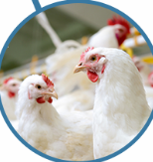
AN EXCELLENT SOLUTION
STERILIZATION • WATER PURIFICATION • DISINFECTION
We are committed to providing modern chemical free and antibiotic free solutions for Disinfection, Hygiene, Water Treatment, Commercial Alkaline Ionized Water with Innovative ecological technologies targeting the Chicken farming market.

Slide 5
ENVIROMENTALLY FRIENDLY CLEAN WATER
Our Envirolyte system uses a state of the art patented Membrane Electrolysis Technology Envirolyte Generator that produces powerful disinfection agents on-site without risks to humans or animals, using just SALT, WATER & ELECTRICITY!
All Natural
Bio-Degradable
100% Totally-Green
Environmentally-Friendly
Non-Toxic
Organic
Electrically Activated Simply From Salt, Electricity, & Water

Slide 6
ANOLYTE
Anolyte is the most effective Non-Chemical disinfectant available and is used to address all types of bacteria, viruses, fungi, spores, and toxic microbial organisms.
Most significantly, micro-organisms cannot build a resistance against it!
Anolyte is up to 300 times more effective than bleach and can be used to replace your existing systems.
The active ingredient, Hypochlorous acid (HOCl), cannot be produced through conventional chemical reactions.

Slide 7
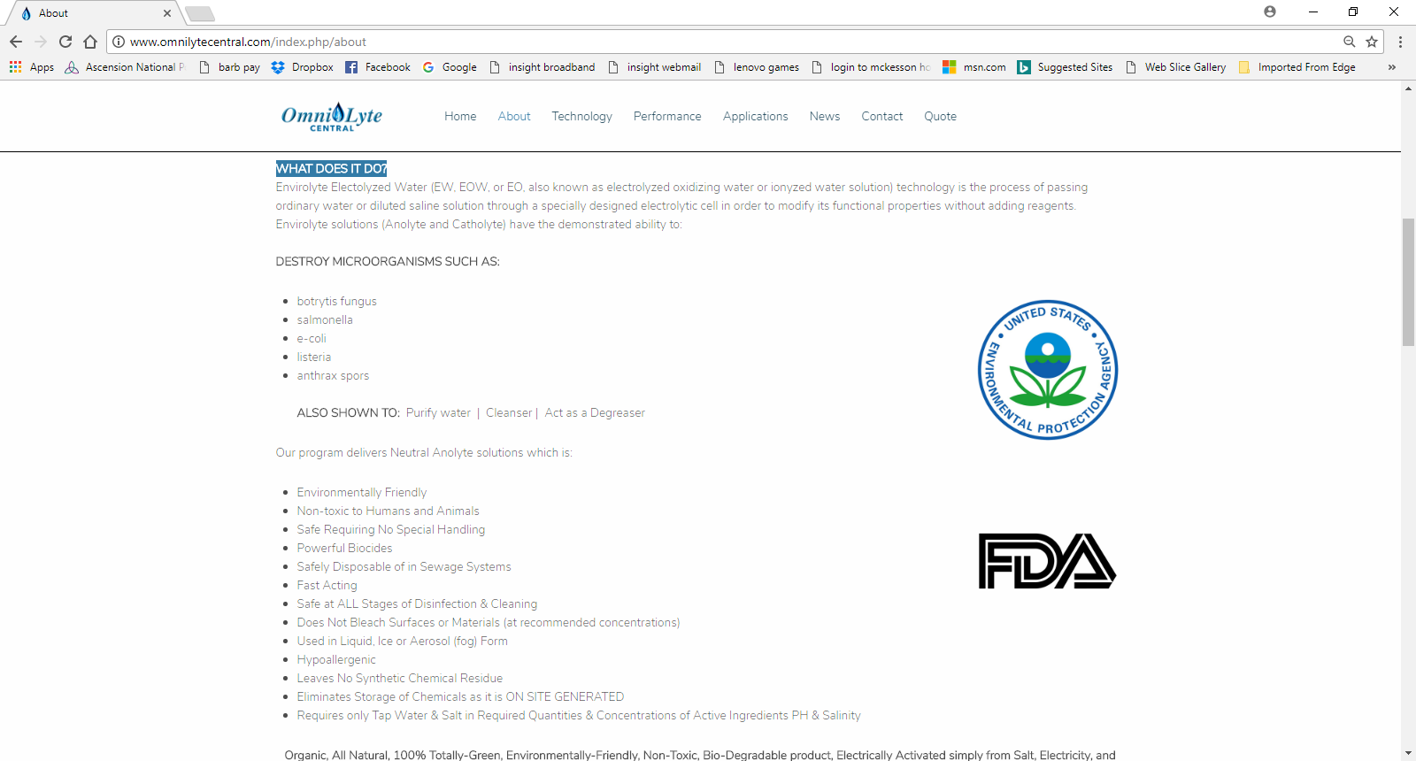

EPA, FDA, & USDA APPROVED
EPA, FDA, and USDA approved, we have found that the use of Envirolyte Electrolyzed Water ECA technology will convincingly improve the bottom line increasing Profitability, Serenity, Safety, & Less Antibiotics in each and every livestock application with rapid system payback, even if the customer testifies he has good water.

Slide 8
WHAT DOES IT DO?
Envirolyte Electolyzed Water (EW, EOW, or EO, also known as electrolyzed oxidizing water or ionized water solution) technology is the process of passing ordinary water or diluted saline solution through a specially designed electrolytic cell in order to modify its functional properties without adding reagents. Envirolyte solutions (Anolyte and Catholyte) have the demonstrated ability to:
DESTROY MICRO-OGRANISMS
PURIFY WATER
ACTS AS CLEANSER & DEGREASER

Slide 9
ORP – IS IT IMPORTANT? YES!
Oxidation-Reduction Potential = Measure of the cleanliness of the water & its ability to break down contaminants.
ORP sensors work by measuring the dissolved oxygen. More contaminants in the water results in less dissolved oxygen because the organic material consumes the oxygen, therefore, the lower the ORP level. The higher the ORP level, the more ability the water has to destroy foreign contaminants such as microbes, or carbon based contaminants.
ORP Level (mV) | Application
0 – 150 | No practical use
150 – 250 | Aquaculture
250 – 350 | Cooling Towers
400 – 475 | Swimming Pools
450 – 600 | Hot Tubs
600 | Water Disinfection
800 | Water Sterilization

Slide 10
ORP AND BACTERIAL ACTIVITY
ORP Level | Coliform count in 100 ml of water
200 | 300
300 | 36
400 | 3
600 | 0
There is a direct relationship between the ORP level and the Coliform count in water. An ORP meter measures the small voltages generated with a platinum or gold probe placed in ozonized water.

Slide 11
EQUIPMENT CAN PRODUCE
TWO BASIC TYPES OF FLUID
1.) Anolyte solutions are strong oxidizing solutions with:
  pH range of 2.5 to 8.5
  ORP (Oxidation-Reduction Potential) of +600 to +1200 mV
Uses include broad spectrum germicidal, disinfectant, purification
2.) Catholyte solutions are anti-oxidizing, mild alkaline solutions with:
  pH of 10.5 to 12.0
  ORP of -600 to -900 mV
Uses include cleanser/detergent, degreaser

Slide 12
BENEFITS OF ANOLYTE APPLICATION
MORTALITY RATE REDUCTION
MEDICINE COST REDUCTION
BETTER FEED CONVERSION RATIO
MORE EFFECTIVE DIESEASE CONTROL & CURE
COMPLETE HYFIENE PROTOCOL WITHOUT CHEMCICALS
BETTER WEIGHT GAIN

Slide 13
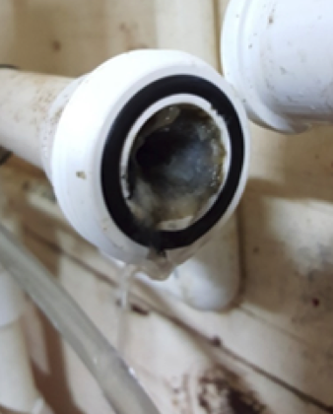
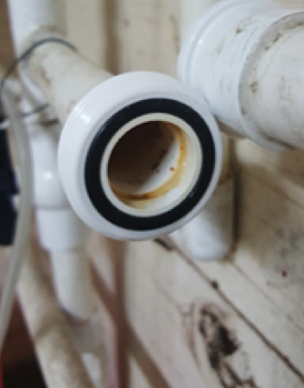
ANOYLYTE DOSING
THE EXCESSIVE BIOFILM IS A
RESULT OF INEFFICIENT DISINFECTION
NO ADDITIONAL LINE CLEANING CHEMICALS WERE USED
BEFORE
ANOYLYTE DOSING
AFTER
ANOYLYTE DOSING

Slide 14
CHLORINATION VS. ANOLYTE
Anolyte is safer and more effective in eradicating hazardous conditions such as Legionella
 | CHLORINATION | ANOLYTE
Solution | Sodium Hypochlorite Solution | Hypochlorous Acid Solution
Compound Description | NAOCL | HOCL
Other Name | Bleach | Anolyte
Usage level | 50 ppm | 0.25 to 5 ppm (even at 500ppm it is Not harmful to people or animals)
MSDS Statements | Very hazardous in case of skin contact, eye contact, ingestion. It is an irritant and corrosive. Prolonged exposure may result in skin burns and ulcerations | Under normal use conditions the likelihood of any adverse health effects are low. The solution is recommended for treatment of infected or purulent wounds. If any irritation occurs, flush with water.
Dose level harmful to people | Yes | No
Kills Legionella | Yes | Yes
Removes Biofilm and Scale, eliminating hidden legionella and other bacteria | No | Yes
At high pH | Hypochlorite Ion (OCl-) | Hypochlorous Acid (HOCl)
Contact time |  | Requires the shorted time to achieve a 99% kill of E. coli
Shelf-life | Lye added resulting in burn potential | No Lye added
Biocidal impact | Only as disinfectant | As Disinfectant and sporicidal agent
Resistance | Bacteria develops resistance to bleach due to its method of attack and residual organisms, biofilm remaining, and interaction with detergents | Bacteria does not develop a the same type of resistance due to impact at cellular level, destroys biofilm, and no need for significant detergent use.

Slide 15
CHLORINATION VS. ANOLYTE
Anolyte is safer and more effective in eradicating hazardous conditions such as Legionella
Disinfectant | Description | Advantages | Limitation
Anolyte | Electrochemical activation of brine solution in a membrane electrolyser | Strong disinfect and and oxidation agent Very effective against all kinds of bacteria and viruses Highly effective as sporicidal agent Effectively eliminates bad tastes and odors Removes biofilms Significantly less formation of chlorine compounds, halogens and TMT No toxic by products: chlorites (ClO2) and chlorates (ClO3) No acute or chronic toxicity when diluted in water Low cost No transport or storage problem Easy and safe storage and handling | Ventilation might be required in the installation room to remove fumes
Chlorine | Used in a gaseous state, requires strictest safety measures | Efficient oxidant and disinfectant Efficiently eliminates tastes and odors Featured with aftereffect Capable of controlling the growth of algae, biological slimes and microorganisms Decomposes organic contaminants (phenols…) Iron and magnesium oxidant. Decomposes hydrogen sulfide, cyanides, ammonium and other nitrogen compounds | Strict requirements for transportation and storage Potential danger for health in case of a leak. Formation of disinfection byproducts, such as chloroform. The MAC in water will be increased in the near future from 60 mkg/l up to 60 mg/l because there was no proof of direct action of the chloroform on DNA.

Slide 16
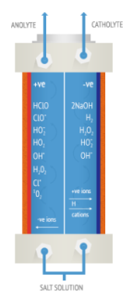
WHAT IS ANOLYTE
Anolyte Water, a mixed oxidant, is produced by electrolyzing dilute brine(NACL) water in the cathode & anode chamber of an unique diaphragmatic electrolytic cell. An electro-chemical activation is used to convert an aqueous solution of sodium chloride into a solution known as “Anolyte.”

Slide 17
ANOLYTE IS SUPERIOR
Only Anolyte can claim to be Effective as a Disinfectant and Safe, Removes Biofilm, Eliminates Algae, is Easy to Maintain, and has a Low Cost throughout its Lifecycle.
Anolyte is Superior to sodium hypochlorite in destroying spores, bacteria, viruses and other pathogens.
For more than 10 years, Anolyte has demonstrated that microorganisms do not develop a resistance against the disinfection power of Anolyte over any period of time
  Pathogens develop a resistance to sodium hypochlorite over time
  Sodium hypochlorite at 5% concentrate disinfects; however, it does NOT sterilize and is NOT effective against cysts (Guardia, Cryptosporidium)

Slide 18
ANOLYTE IS SUPERIOR
Anolyte has a lower kill time
  - Sodium hypochlorite loses its strength during long-term storage and is a potential danger due to the production of gaseous chlorine emissions during storage period
Anolyte is more soluble
Anolyte is effective as a bactericidal at pH values of 4-9
Anolyte can be produced at an ORP up to +1200 making it more effective as a biocide (+800 is pure sterilization)
Anolyte is minimally corrosive – Anolyte is the Product of choice for disinfection
Anolyte produces about half the trihalomethanes when interacting with organic material in comparison to traditional chlorine use.
Anolyte is anti-scaling:
  - Eliminates existing scale
  - Eliminates pathogens being harbored within scale
  - Blocks any dissolved solids within the water supply, so new scale is prevented
  from forming.

Slide 19
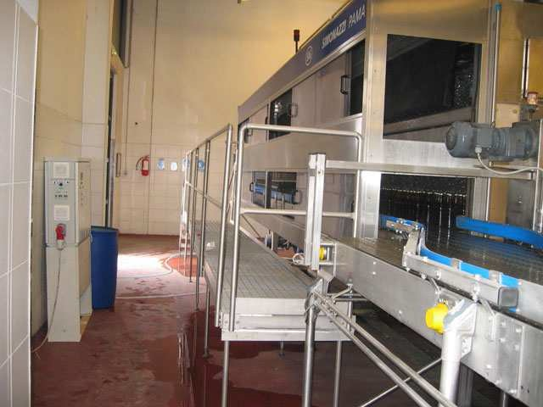
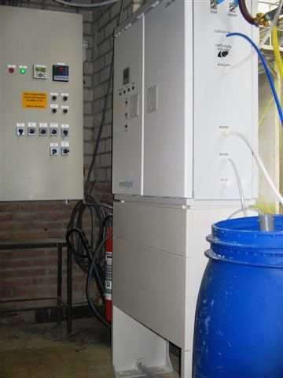
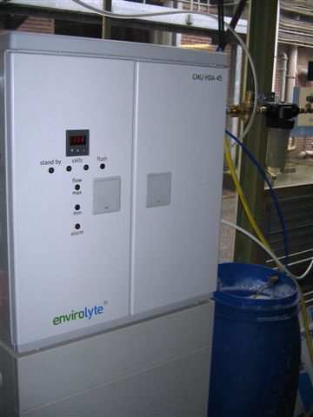
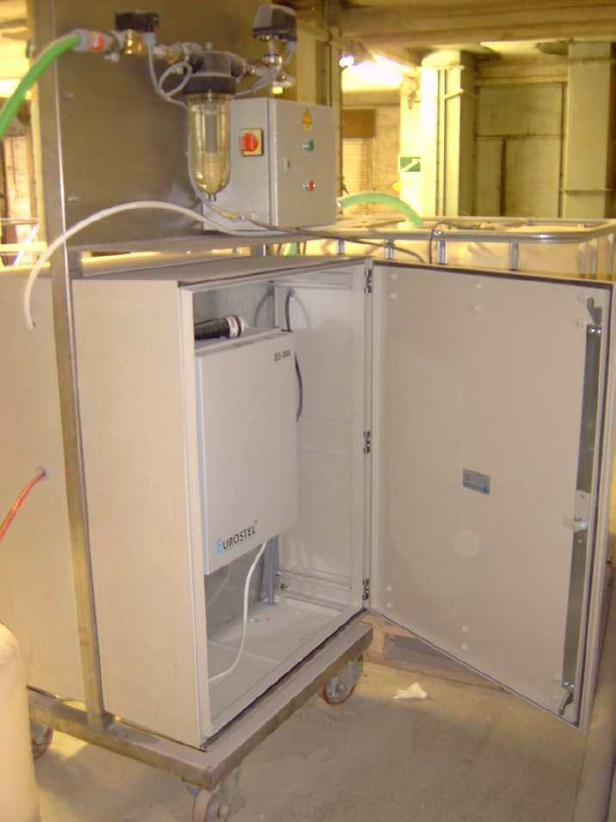
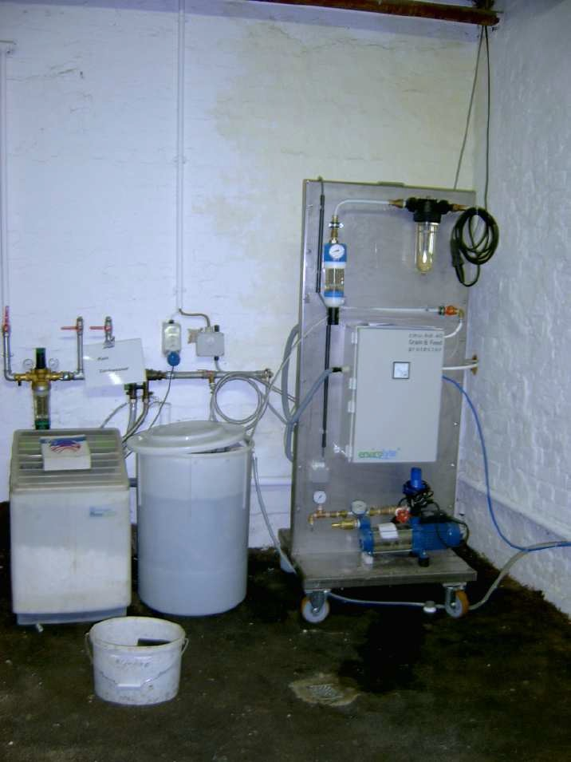
CUSTOM ENVIROLYTE INSTALLS

Slide 20
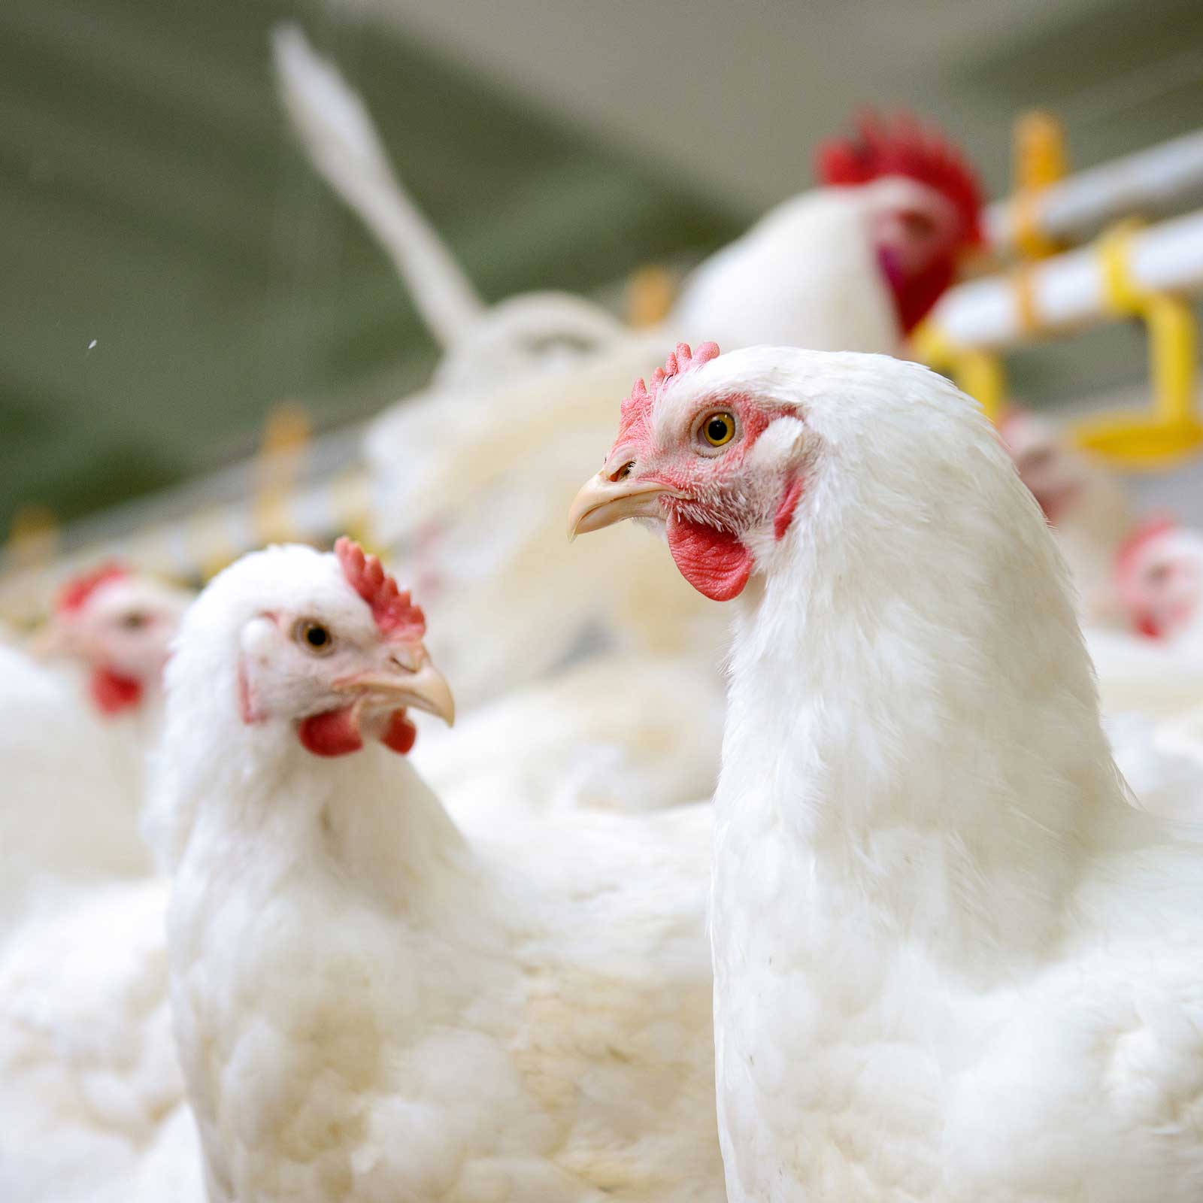
CHICKENS
Increase yields
  Shorter cycles, higher indexes
  Eggs more resistant and bigger
Lower mortality rate
  Animals are more resistant and healthier
  Reduction of antibiotic and drug use
  Direct effect on digestion: better uptake of nutrients, reduction of feed consumption, less digestive problems
Excellent ROI
  Reduction of variable costs
  Easy installation, low maintenance

Slide 21
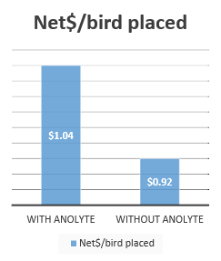
ASPENHEIM FARMS
Client: Aspenheim Farms, Bagot , Manitoba, Canada Size: 50000 Broiler Farm operation Unit: Envirolyte ELA-1200 Dosage: 4% Anolyte Pump: Iwaki IX Series Extras: Water Softener, Anolyte Fogger Previous Technology: Chlorine dioxide
“After installing the system and deploying the Anolyte solution we immediately noticed a huge difference in our operation. The Anolyte cut our mortality rate under half, from an average of 4% to ~2% with better shipping weights, better feed conversion, cleaner water lines and lower condemned percentage. Anolyte is also used to disinfect and clean the barn with fogger supplied by Omnilyte.” The chart was computed over 5 batches with no Anolyte versus 3 batches with Anolyte. Overall, great investment, and would recommend this product to everyone.

Slide 22
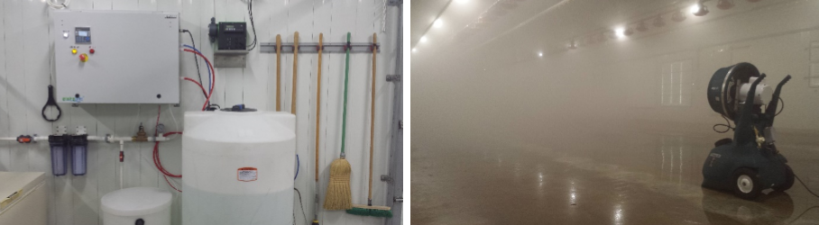
COOLSPRING FARMS
“This ELA-2000 Envirolyte Anolyte Generator System supplied by OmniLyte is the best investment we have made on the farm with a ROI in less than 2 batches!” [Coolspring Colony]
“After Installing the system and deploying the Anolyte solution we immediately noticed a huge difference in our operation. The Anolyte Solution reduced the average mortality by 57% (from an average of 7% to 3%), increased weight gain by 5%, and reduced the condemned by 6%. The Anolyte also eliminated the use of costly ph correction acid dosages, reducing all biofilms within a week of installation; thus, eliminating between the batch line cleaning with chemicals with more Serenity, more Profitability, more Safety, less Antibiotic use.”
87000 Broiler
Farm operation
Unit: Envirolyte ELA-2000
Dosage: 7% Anolyte

Slide 23
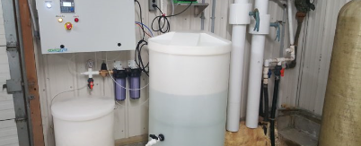
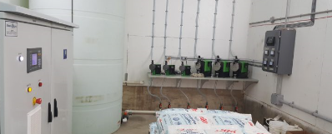
SPRINGFIELD FARMS, CANADA
Installed an ELA-200 Anolyte Generator for their 25000 Broiler Farm
SPRINGFIELD FARMS, CANADA
Installed an ELA-18000 Anolyte Generator for their Public water System, 1200 Hog Barn, Hatchery, and Dairy

Slide 24
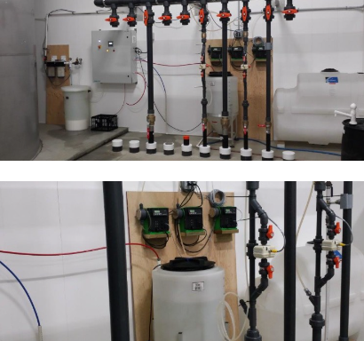
MIDWEST FARMS, CANADA
Installed an ELA-3000 and began dosing Anolyte for their 36000 broiler farm.
Only technology that efficiently eliminated the tough to kill (SRB) Sulfur reducing bacteria with minimal taste and odor.

Slide 25
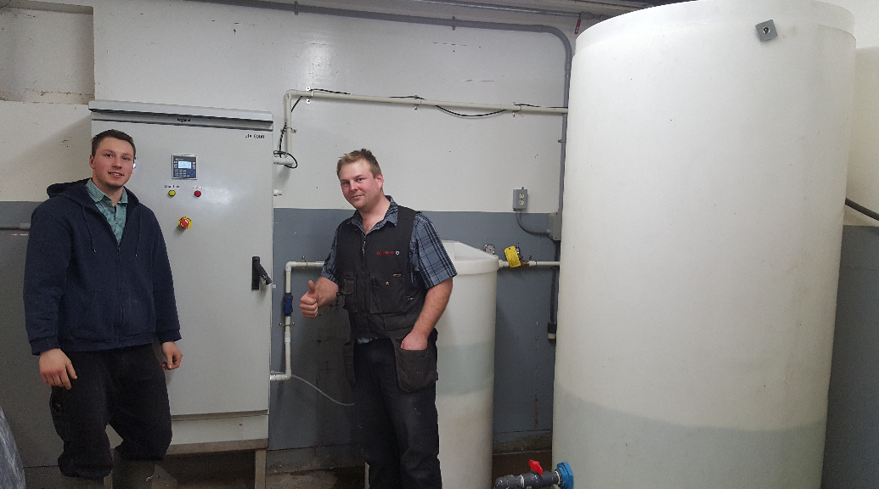
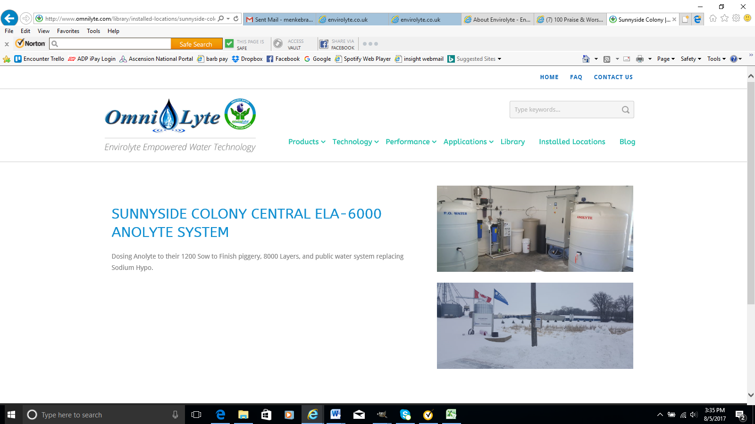
STARLIGHT FARMS
Installed an ELA-6000 Water Electrolyzer to produce Anolyte for their 600 sow to finish Hog operation, Turkey, and Layers.
SUNNYSIDE FARMS
Installed an ELA-6000 and began dosing Anolyte for their 1200 piggery, and 8000 Layers system replacing Sodium Hypo.

Slide 26
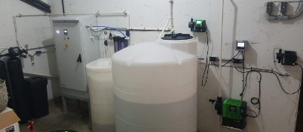
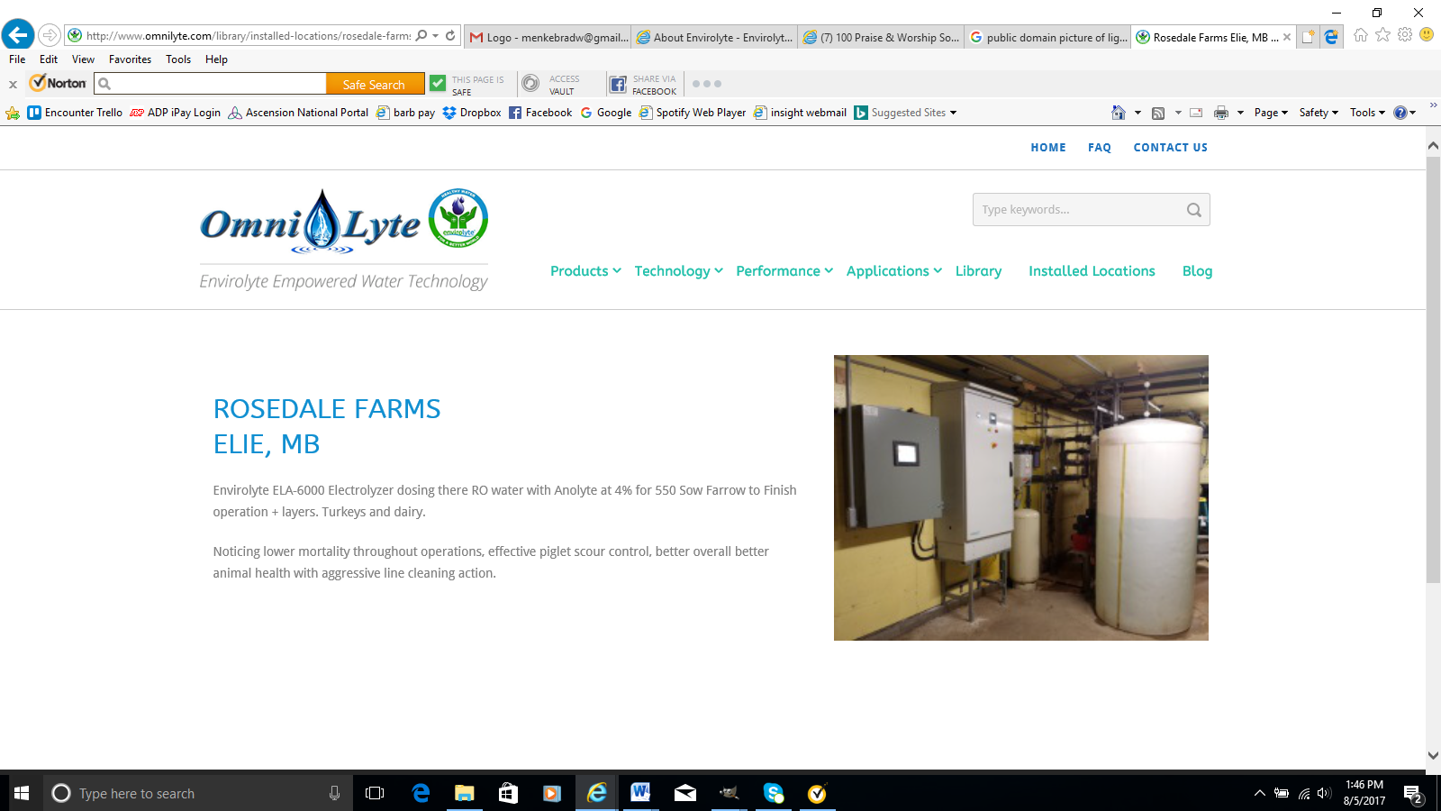
SANALTA (TRIPLE S FARMS) CANADA
Dosing their 750000 Layers dosing Anolyte at 2%
ROSEDALE FARMS, CANADA
Installed an ELA-6000 Electrolyzer dosing their RO water with Anolyte at 4% for 550 Turkey Pig, Dairy, and Layer Operation.
Noticing lower mortality and better overall animal health with aggressive line cleaning action.

Slide 27
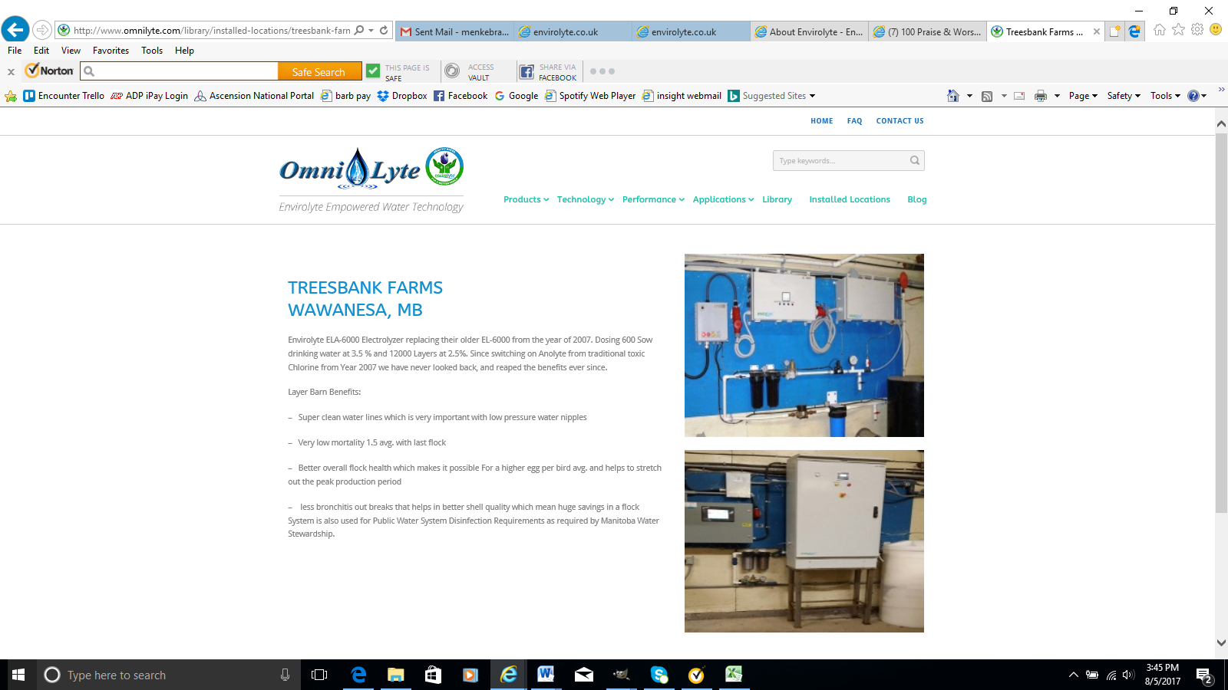
TREESBANK FARMS, CANADA
Installed an ELA-6000 Electrolyzer and began dosing their 600 Sows at 3.5% and 12000 Layers at 2.5%. Since switching on Anolyte from traditional toxic Chlorine in 2007, we have never looked back, and reaped the benefits ever since.
– Super clean water lines which is very important with low pressure water nipples
– Very low mortality 1.5 avg. with last flock
– Better overall flock health
– Higher egg per bird average
– Less bronchitis out breaks
– Better shell quality

Slide 28
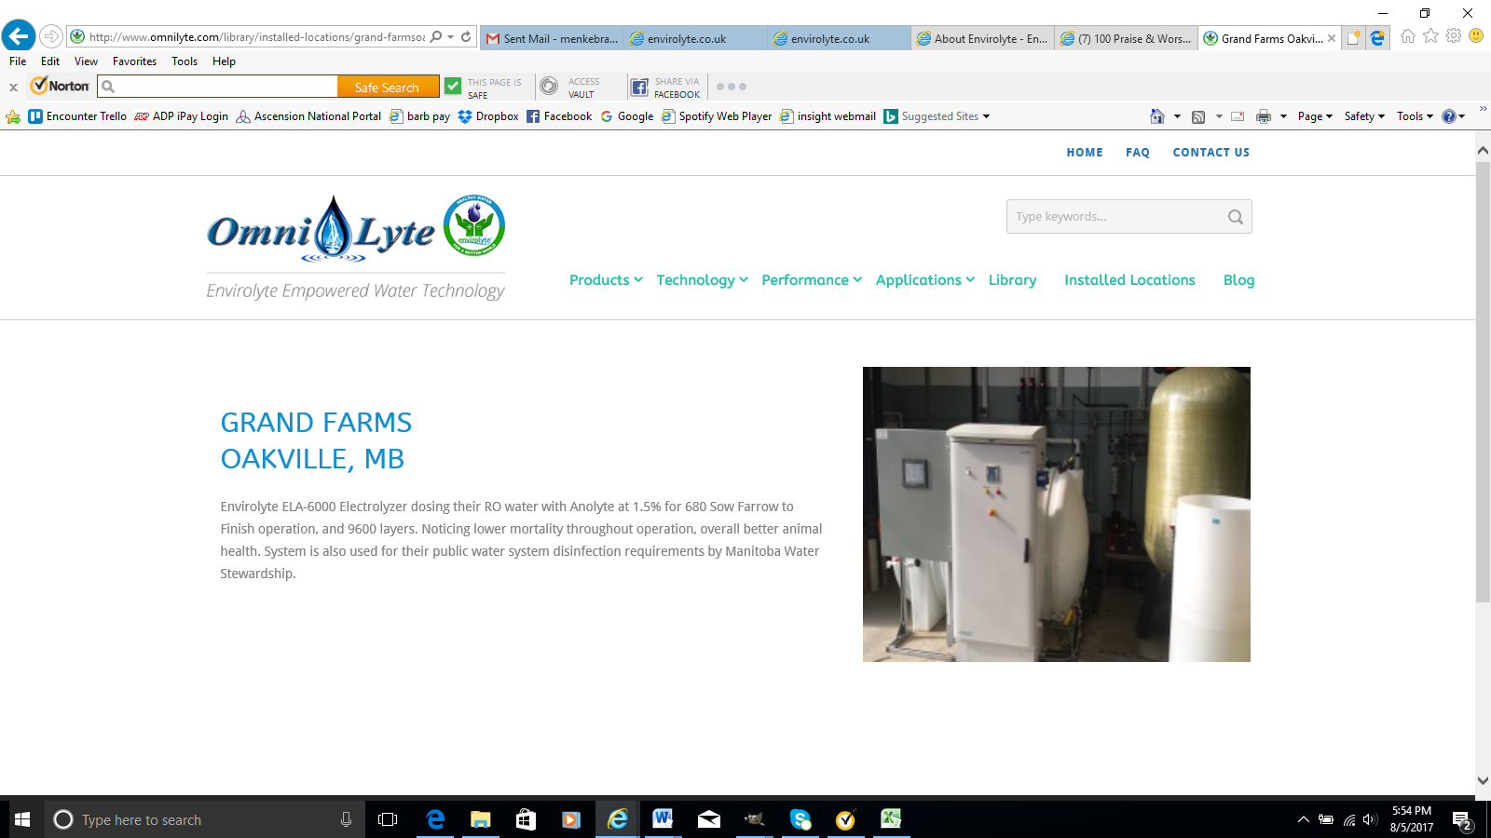
GRAND FARMS, CANADA
Installed an ELA-6000 Electrolyzer and began dosing their RO water with Anolyte at 1.5% for their 680 Sow operation and 9600 layers, noticing lower mortality and overall better animal health.

Slide 29
NEXT STEPS
Call OmniLyte Central
  (270) 318-0677
  Ask For Sam
Request Anolyte to Try
Get a Quote on a complete system
Replace Existing System
  Eliminate Antibiotics
  Reduce Operating Expenses
  Improve Animal Health
  Increase Profitability

Slide 30
Sam Hofer: Sales & Marketing
Phone: 270-318-0677
Email: sam@OmniLyteUSA.com
Website: omnilytecentral.com

